Slide 1
Digital Communication
Gaurav S. Kasbekar
Dept. of Electrical Engineering
IIT Bombay

Slide 2
Analog and Digital Communications
Digital communication systems have replaced or are replacing analog communication systems
E.g.:
first generation cellular phone technology was analog (Advanced Mobile Phone Service (AMPS))
2G (Global System for Mobile communication (GSM)) and subsequent cellular phone technologies (e.g., CDMA, LTE-Advanced and 5G) have been digital
E.g.:
Digital TV broadcasting replacing analog TV broadcasting worldwide
“Analog communication” and “digital communication”:
in practice, all communication is via continuous signals and hence analog in nature
the message signal that is to be transmitted is either analog or digital
E.g., if the source is speech, then:
In analog communication it is directly used to modulate a high-frequency carrier signal
In digital communication, it is sampled and quantized to obtain a bit stream, which is then used to modulate a high-frequency carrier signal

Slide 3
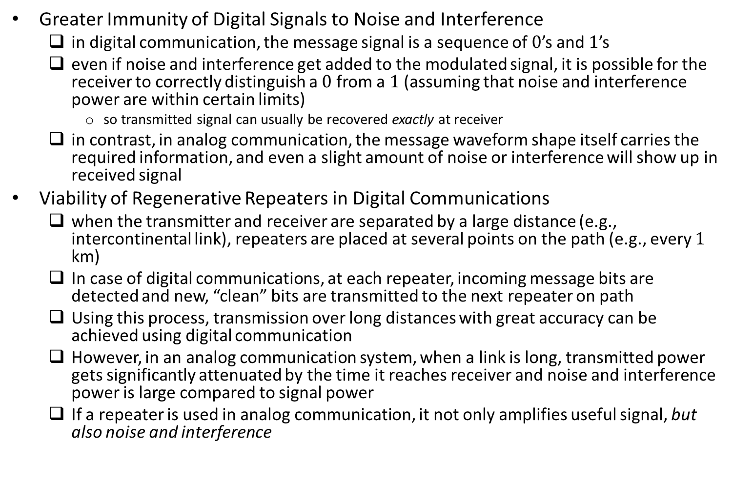
Reasons Why Digital Communication Outperforms Analog Communication
Greater Immunity of Digital Signals to Noise and Interference
in digital communication, the message signal is a sequence of $0$’s and $1$’s
even if noise and interference get added to the modulated signal, it is possible for the receiver to correctly distinguish a $0$ from a $1$ (assuming that noise and interference power are within certain limits)
so transmitted signal can usually be recovered exactly at receiver
in contrast, in analog communication, the message waveform shape itself carries the required information, and even a slight amount of noise or interference will show up in received signal
Viability of Regenerative Repeaters in Digital Communications
when the transmitter and receiver are separated by a large distance (e.g., intercontinental link), repeaters are placed at several points on the path (e.g., every $1$ km)
In case of digital communications, at each repeater, incoming message bits are detected and new, “clean” bits are transmitted to the next repeater on path
Using this process, transmission over long distances with great accuracy can be achieved using digital communication
However, in an analog communication system, when a link is long, transmitted power gets significantly attenuated by the time it reaches receiver and noise and interference power is large compared to signal power
If a repeater is used in analog communication, it not only amplifies useful signal, but also noise and interference

Slide 4
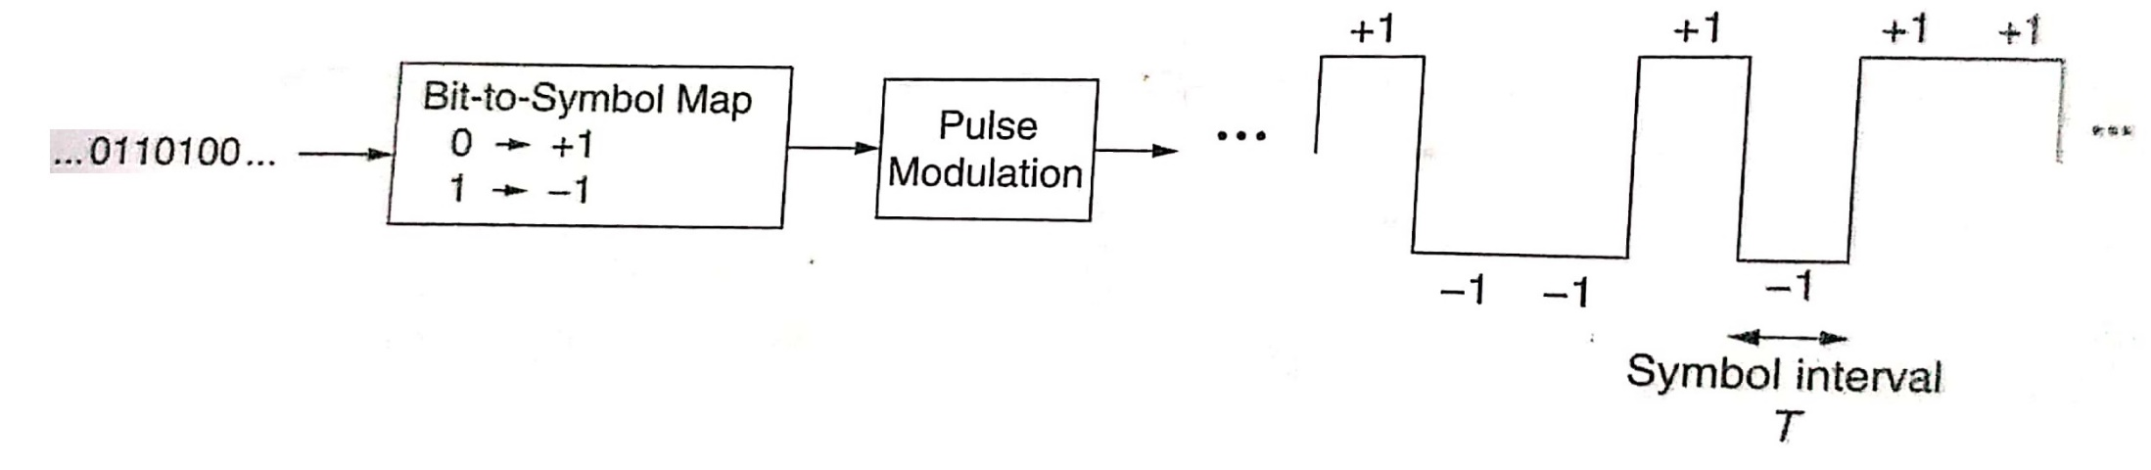
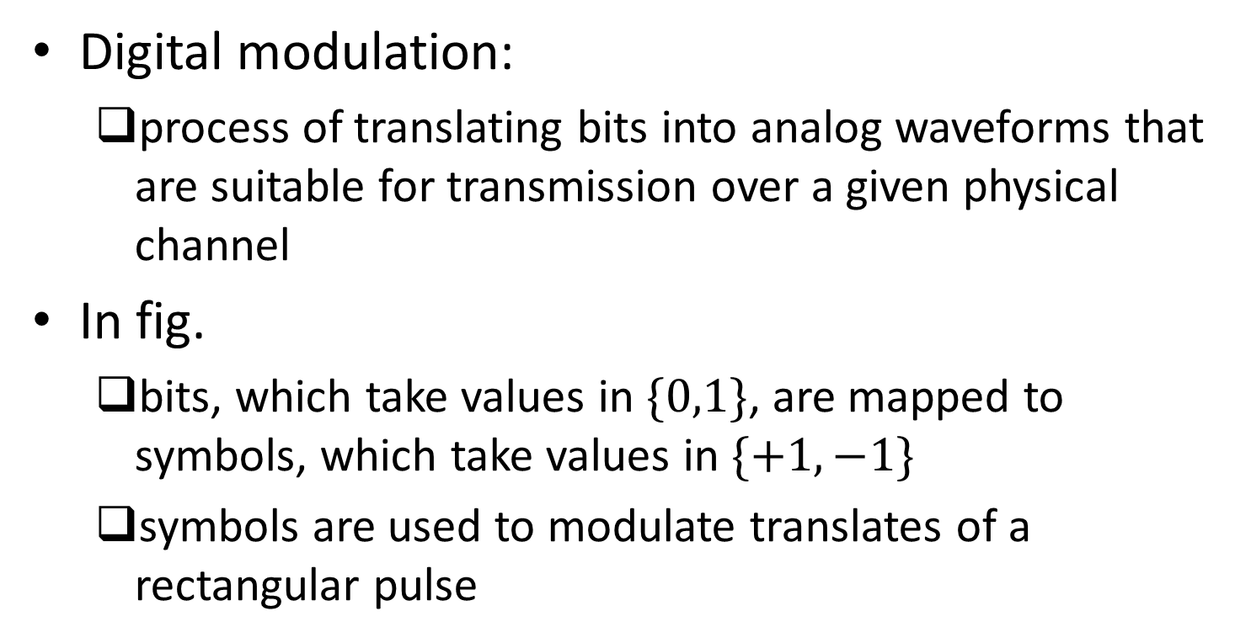
Overview of Digital Modulation
Digital modulation:
process of translating bits into analog waveforms that are suitable for transmission over a given physical channel
In fig.
bits, which take values in $\{0,1\}$, are mapped to symbols, which take values in $\{+1,−1\}$
symbols are used to modulate translates of a rectangular pulse
Ref: U. Madhow, “Introduction to Communication Systems”

Slide 5
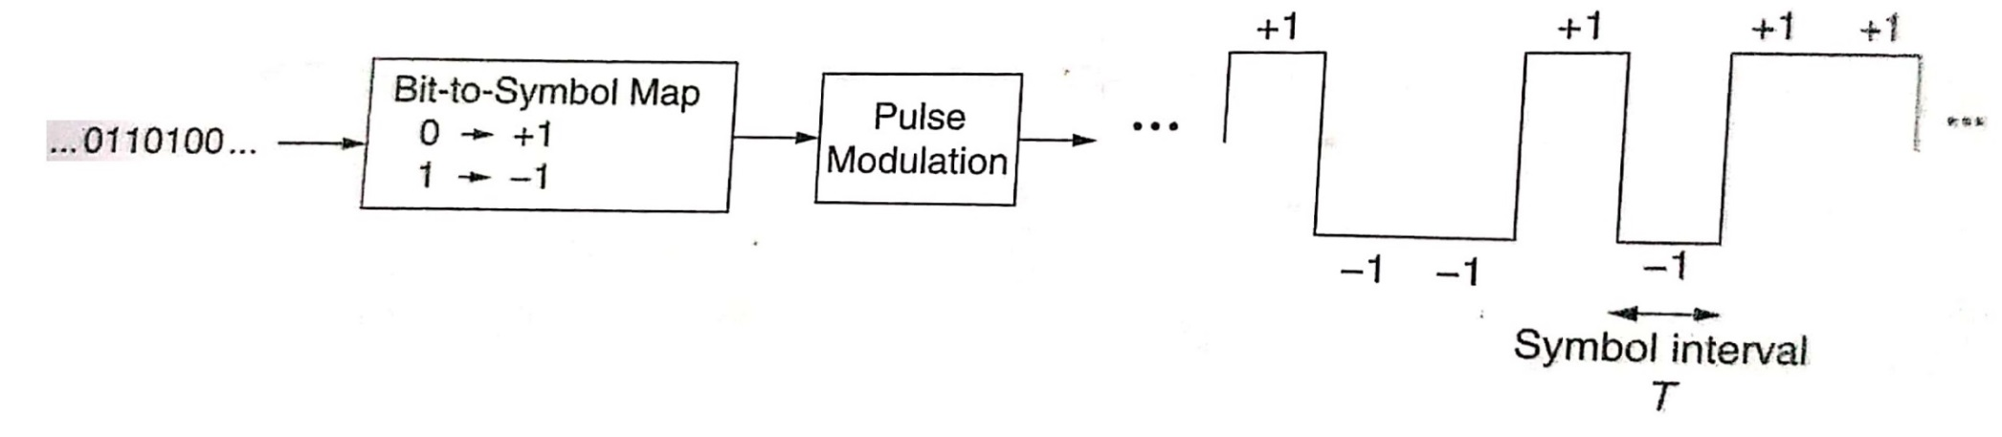
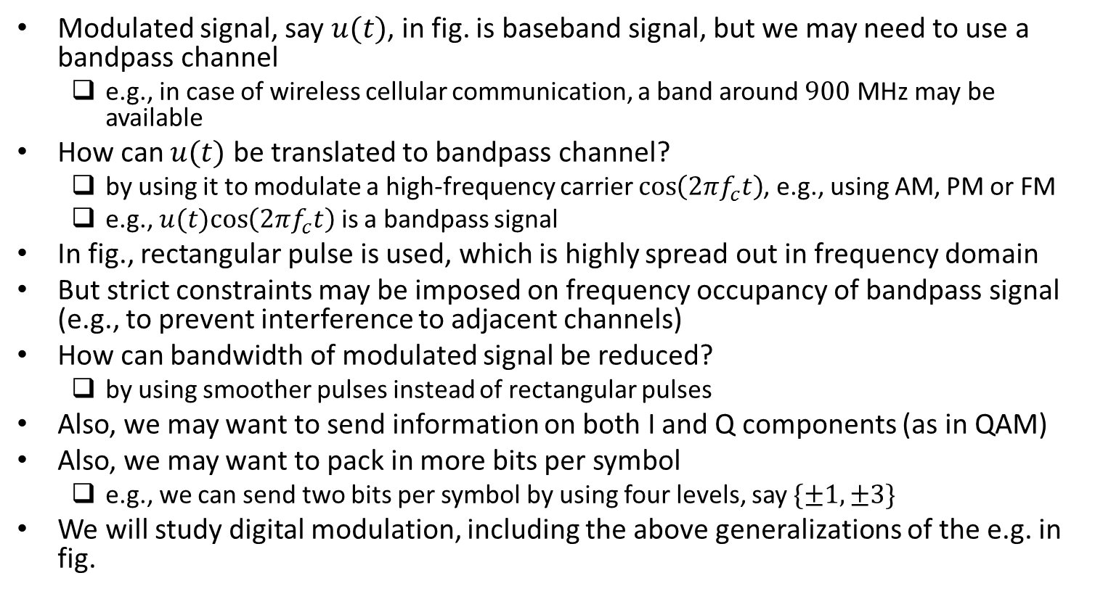
Overview of Digital Modulation (contd.)
Modulated signal, say $u(t)$, in fig. is baseband signal, but we may need to use a bandpass channel
e.g., in case of wireless cellular communication, a band around $900$ MHz may be available
How can $u(t)$ be translated to bandpass channel?
by using it to modulate a high-frequency carrier $\cos\left(2πf_{c}t\right)$, e.g., using AM, PM or FM
e.g., $u(t)cos\left(2πf_{c}t\right)$ is a bandpass signal
In fig., rectangular pulse is used, which is highly spread out in frequency domain
But strict constraints may be imposed on frequency occupancy of bandpass signal (e.g., to prevent interference to adjacent channels)
How can bandwidth of modulated signal be reduced?
by using smoother pulses instead of rectangular pulses
Also, we may want to send information on both I and Q components (as in QAM)
Also, we may want to pack in more bits per symbol
e.g., we can send two bits per symbol by using four levels, say $\{±1,±3\}$
We will study digital modulation, including the above generalizations of the e.g. in fig.
Ref: U. Madhow, “Introduction to Communication Systems”

Slide 6

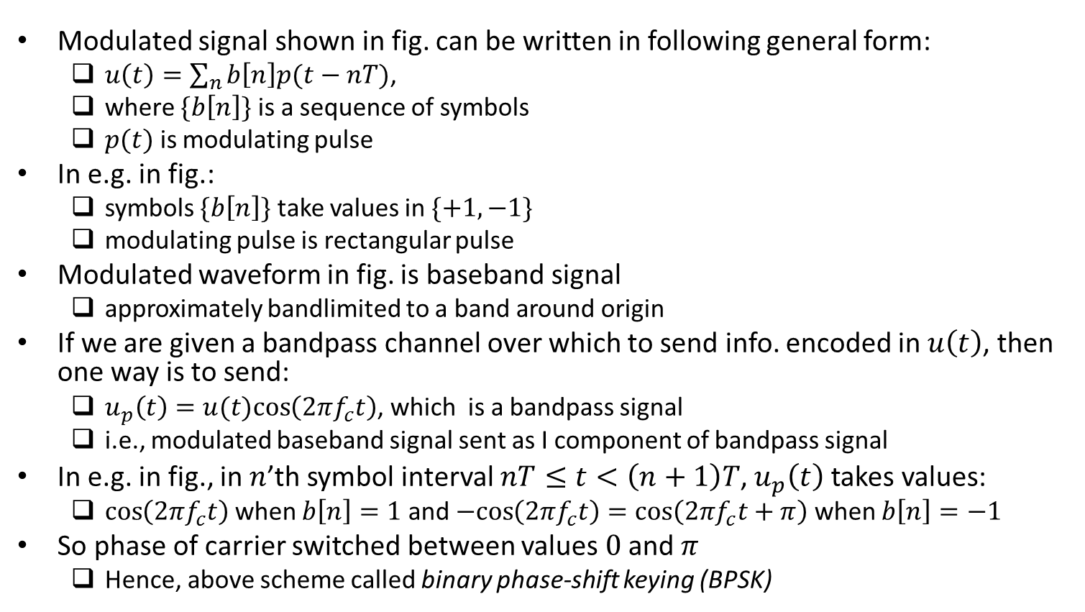
Mathematical Representation
Modulated signal shown in fig. can be written in following general form:
$u\left(t\right)=\sum_{n}{b\left[n\right]p(t−nT)}$,
where $\{b\left[n\right]\}$ is a sequence of symbols
$p(t)$ is modulating pulse
In e.g. in fig.:
symbols $\{b\left[n\right]\}$ take values in $\{+1,−1\}$
modulating pulse is rectangular pulse
Modulated waveform in fig. is baseband signal
approximately bandlimited to a band around origin
If we are given a bandpass channel over which to send info. encoded in $u\left(t\right)$, then one way is to send:
$u_{p}\left(t\right)=u(t)cos\left(2πf_{c}t\right)$, which is a bandpass signal
i.e., modulated baseband signal sent as I component of bandpass signal
In e.g. in fig., in $n$’th symbol interval $nT≤t<\left(n+1\right)T$, $u_{p}\left(t\right)$ takes values:
$\cos\left(2πf_{c}t\right)$ when $b\left[n\right]=1$ and $−cos\left(2πf_{c}t\right)=\cos\left(2πf_{c}t+π\right)$ when $b\left[n\right]=−1$
So phase of carrier switched between values $0$ and $π$
Hence, above scheme called binary phase-shift keying (BPSK)
Ref: U. Madhow, “Introduction to Communication Systems”

Slide 7
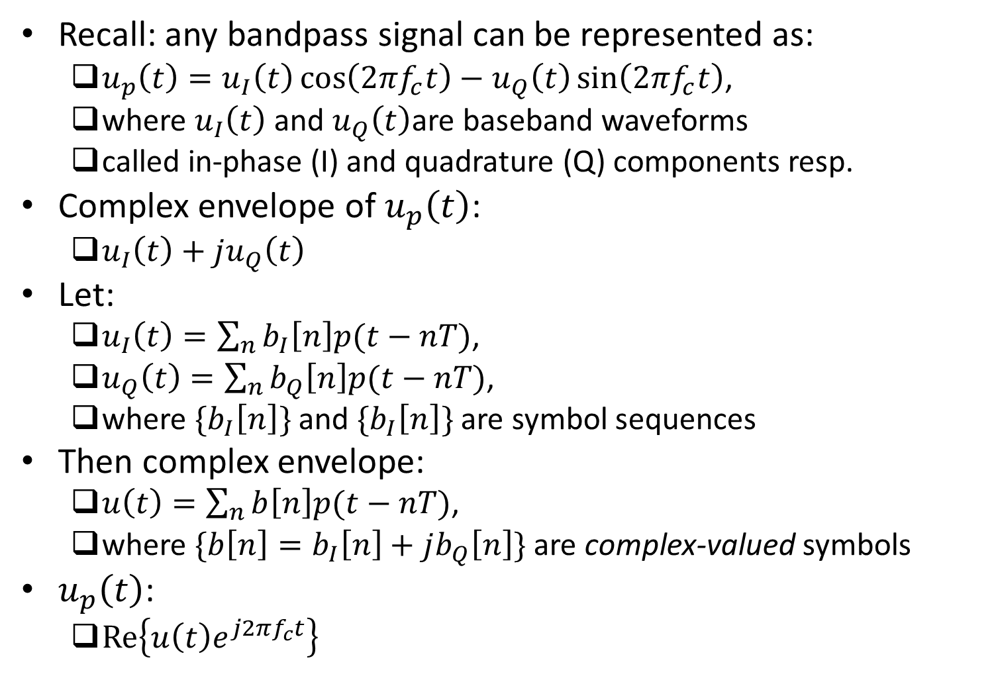
Mathematical Representation (contd.)
Recall: any bandpass signal can be represented as:
$u_{p}\left(t\right)=u_{I}\left(t\right)\cos\left(2πf_{c}t\right)−u_{Q}\left(t\right)\sin\left(2πf_{c}t\right)$,
where $u_{I}\left(t\right)$ and $u_{Q}\left(t\right)$are baseband waveforms
called in-phase (I) and quadrature (Q) components resp.
Complex envelope of $u_{p}\left(t\right)$:
$u_{I}\left(t\right)+ju_{Q}\left(t\right)$
Let:
$u_{I}\left(t\right)=\sum_{n}{b_{I}\left[n\right]p(t−nT)}$,
$u_{Q}\left(t\right)=\sum_{n}{b_{Q}\left[n\right]p(t−nT)}$,
where ${\{b}_{I}\left[n\right]\}$ and ${\{b}_{I}\left[n\right]\}$ are symbol sequences
Then complex envelope:
$u\left(t\right)=\sum_{n}{b\left[n\right]p(t−nT)}$,
where $\{b\left[n\right]=b_{I}\left[n\right]+jb_{Q}\left[n\right]\}$ are complex-valued symbols
$u_{p}\left(t\right)$:
$Re\left\{u\left(t\right)e^{j2πf_{c}t}\right\}$

Slide 8
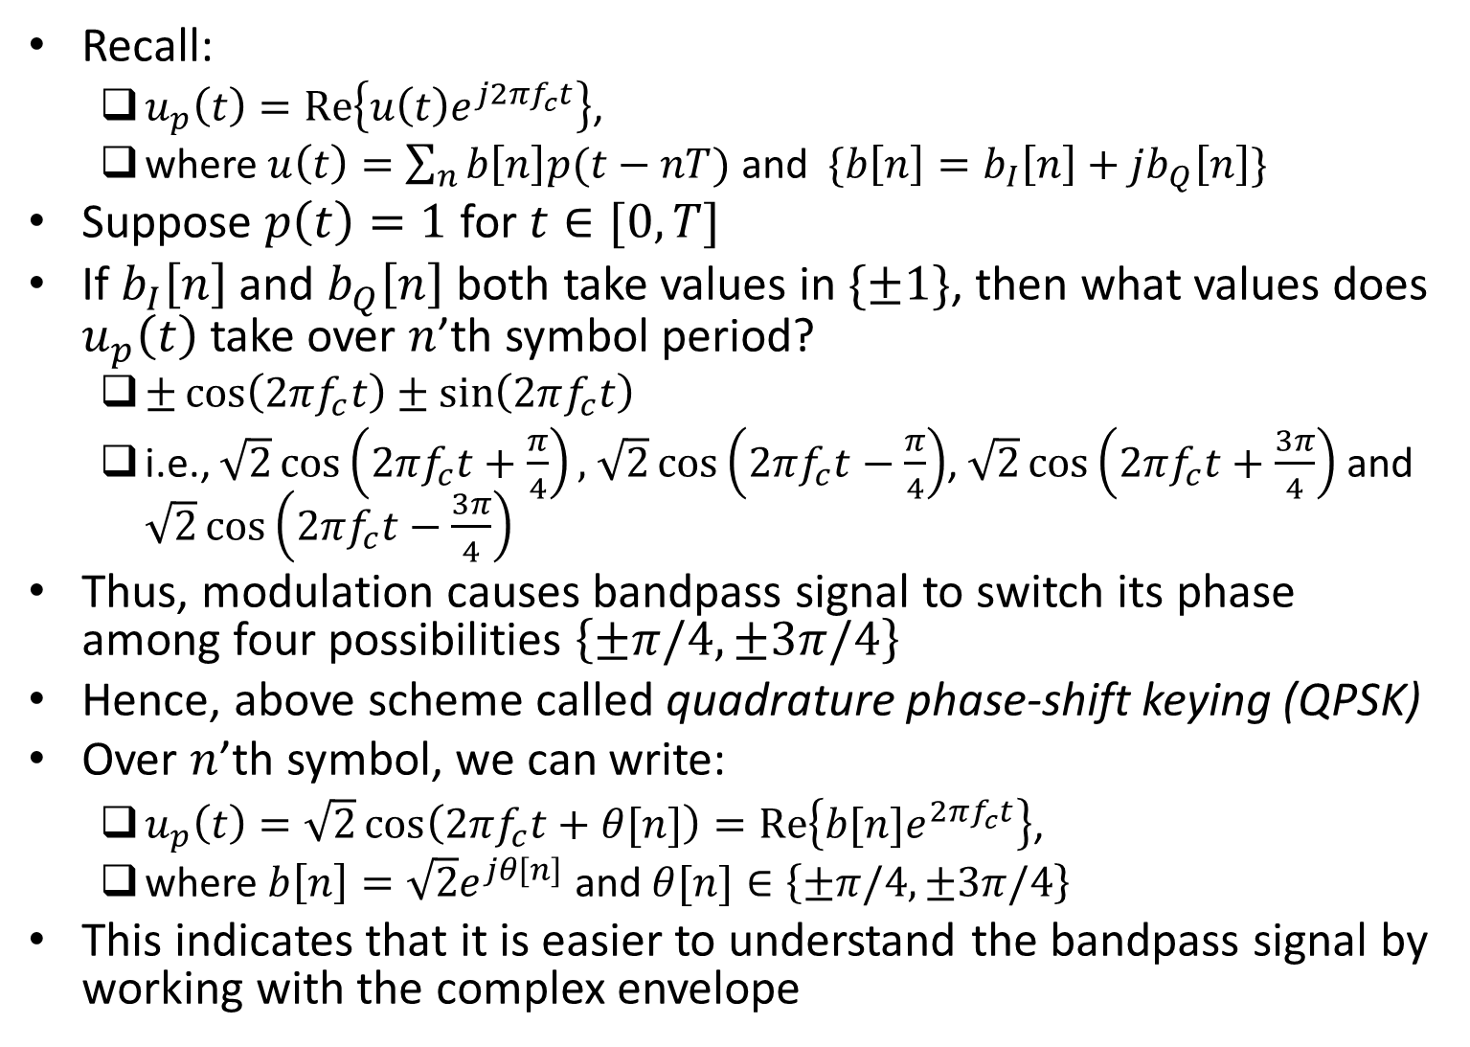
Example
Recall:
$u_{p}\left(t\right)=Re\left\{u\left(t\right)e^{j2πf_{c}t}\right\}$,
where $u\left(t\right)=\sum_{n}{b\left[n\right]p(t−nT)}$ and $\{b\left[n\right]=b_{I}\left[n\right]+jb_{Q}\left[n\right]\}$
Suppose $p\left(t\right)=1$ for $t∈[0,T]$
If $b_{I}\left[n\right]$ and $b_{Q}\left[n\right]$ both take values in $\{±1\}$, then what values does $u_{p}\left(t\right)$ take over $n$’th symbol period?
$±\cos\left(2πf_{c}t\right)±\sin\left(2πf_{c}t\right)$
i.e., $\sqrt{2}\cos\left(2πf_{c}t+\frac{π}{4}\right),$ $\sqrt{2}\cos\left(2πf_{c}t−\frac{π}{4}\right)$, $\sqrt{2}\cos\left(2πf_{c}t+\frac{3π}{4}\right)$ and $\sqrt{2}\cos\left(2πf_{c}t−\frac{3π}{4}\right)$
Thus, modulation causes bandpass signal to switch its phase among four possibilities $\left\{±π/4,±3π/4\right\}$
Hence, above scheme called quadrature phase-shift keying (QPSK)
Over $n$’th symbol, we can write:
$u_{p}\left(t\right)=\sqrt{2}\cos\left(2πf_{c}t+θ[n]\right)=Re\left\{b[n]e^{2πf_{c}t}\right\}$,
where $b\left[n\right]=\sqrt{2}e^{jθ[n]}$ and $θ[n]∈\left\{±π/4,±3π/4\right\}$
This indicates that it is easier to understand the bandpass signal by working with the complex envelope

Slide 9
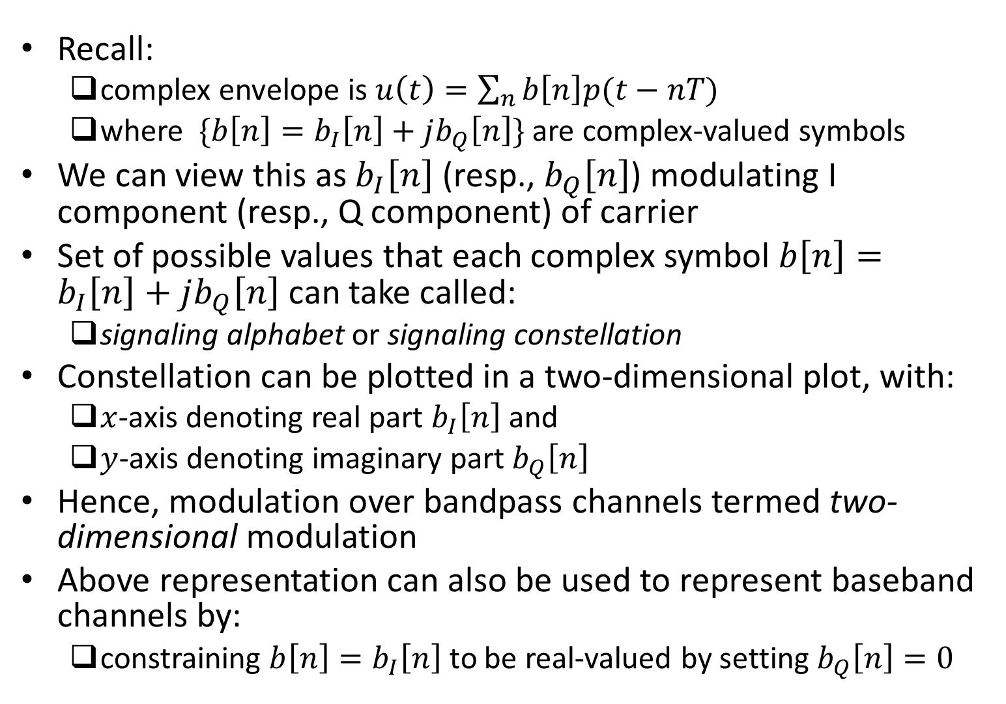
Signal Constellations
Recall:
complex envelope is $u\left(t\right)=\sum_{n}{b\left[n\right]p(t−nT)}$
where $\{b\left[n\right]=b_{I}\left[n\right]+jb_{Q}\left[n\right]\}$ are complex-valued symbols
We can view this as $b_{I}\left[n\right]$ (resp., $b_{Q}\left[n\right]$) modulating I component (resp., Q component) of carrier
Set of possible values that each complex symbol $b\left[n\right]=b_{I}\left[n\right]+jb_{Q}\left[n\right]$ can take called:
signaling alphabet or signaling constellation
Constellation can be plotted in a two-dimensional plot, with:
$x$-axis denoting real part $b_{I}\left[n\right]$ and
$y$-axis denoting imaginary part $b_{Q}\left[n\right]$
Hence, modulation over bandpass channels termed two-dimensional modulation
Above representation can also be used to represent baseband channels by:
constraining $b\left[n\right]=b_{I}\left[n\right]$ to be real-valued by setting $b_{Q}\left[n\right]=0$

Slide 10
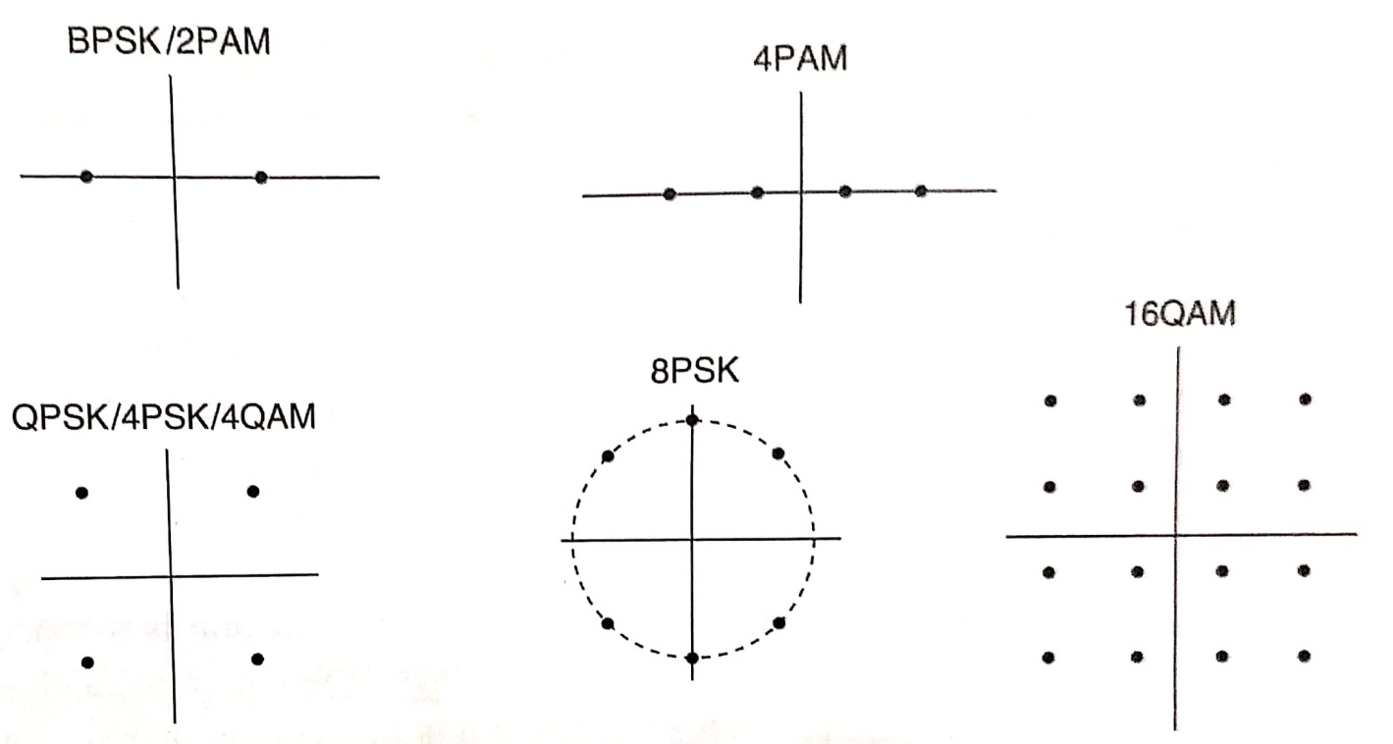
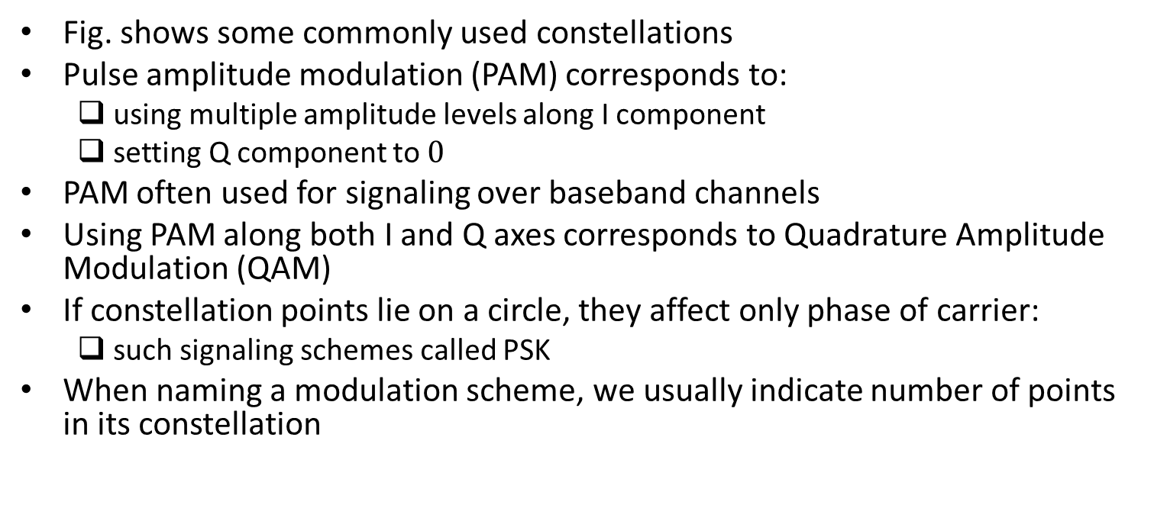
Some Commonly Used Constellations
Fig. shows some commonly used constellations
Pulse amplitude modulation (PAM) corresponds to:
using multiple amplitude levels along I component
setting Q component to $0$
PAM often used for signaling over baseband channels
Using PAM along both I and Q axes corresponds to Quadrature Amplitude Modulation (QAM)
If constellation points lie on a circle, they affect only phase of carrier:
such signaling schemes called PSK
When naming a modulation scheme, we usually indicate number of points in its constellation
BPSK (or 2PSK) can also be classified as 2PAM; QPSK (or 4PSK) can also be classified as 4QAM
Ref: U. Madhow, “Introduction to Communication Systems”

Slide 11
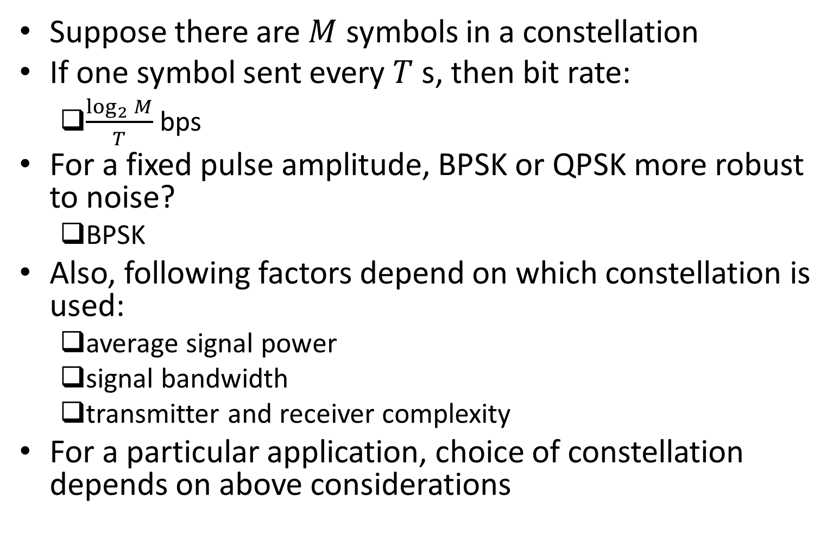
Choice of Constellation
Suppose there are $M$ symbols in a constellation
If one symbol sent every $T$ s, then bit rate:
$\frac{\log_{2}{M}}{T}$ bps
For a fixed pulse amplitude, BPSK or QPSK more robust to noise?
BPSK
Also, following factors depend on which constellation is used:
average signal power
signal bandwidth
transmitter and receiver complexity
For a particular application, choice of constellation depends on above considerations

Slide 12
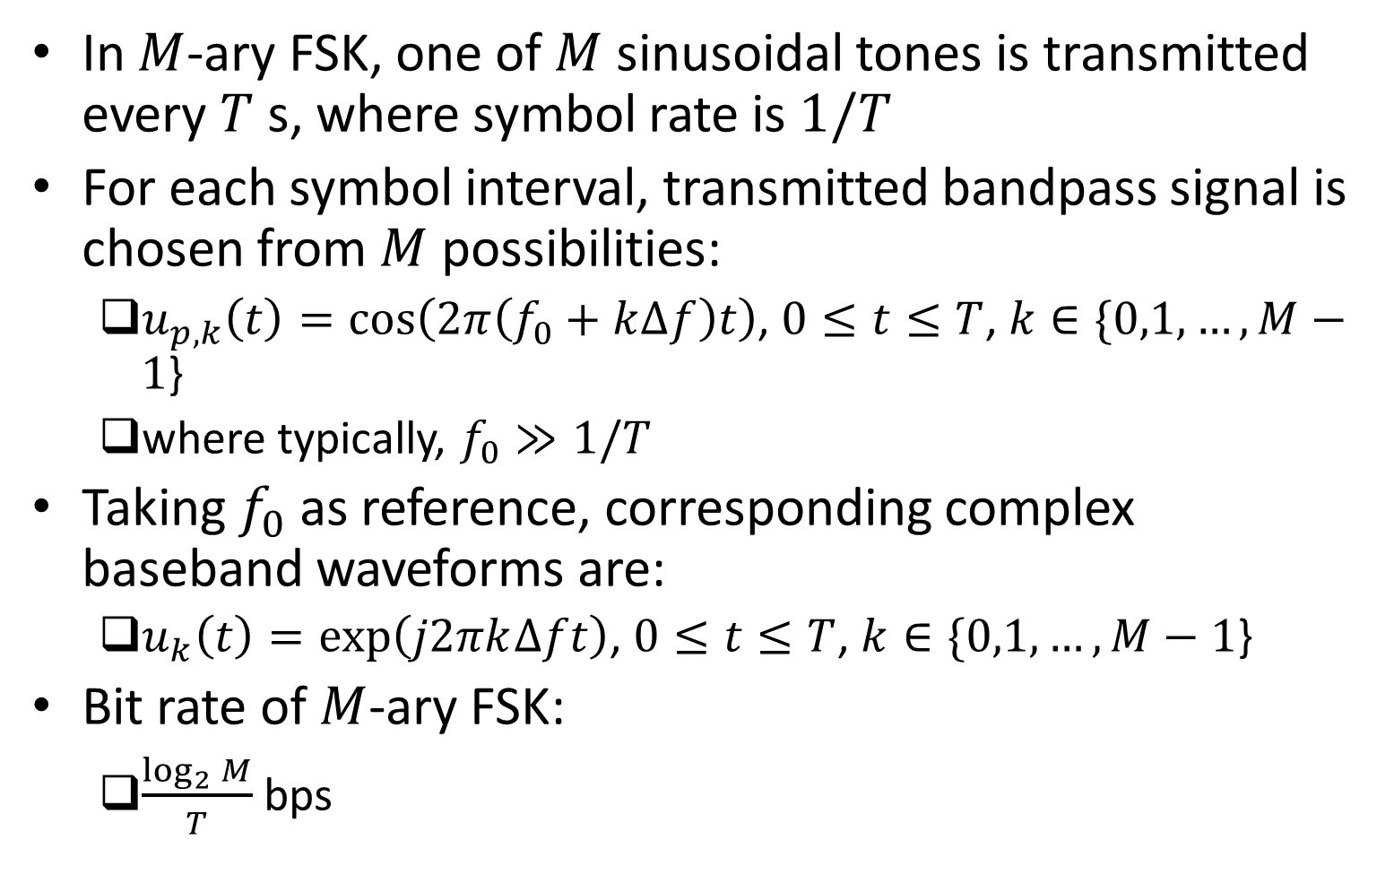
Frequency Shift Keying (FSK)
In $M$-ary FSK, one of $M$ sinusoidal tones is transmitted every $T$ s, where symbol rate is $1/T$
For each symbol interval, transmitted bandpass signal is chosen from $M$ possibilities:
$u_{p,k}\left(t\right)=\cos\left(2π\left(f_{0}+k∆f\right)t\right)$, $0≤t≤T$, $k∈\{0,1,…,M−1$}
where typically, $f_{0}≫1/T$
Taking $f_{0}$ as reference, corresponding complex baseband waveforms are:
$u_{k}\left(t\right)=exp\left(j2πk∆ft\right)$, $0≤t≤T$, $k∈\{0,1,…,M−1$}
Bit rate of $M$-ary FSK:
$\frac{\log_{2}{M}}{T}$ bps

Slide 13
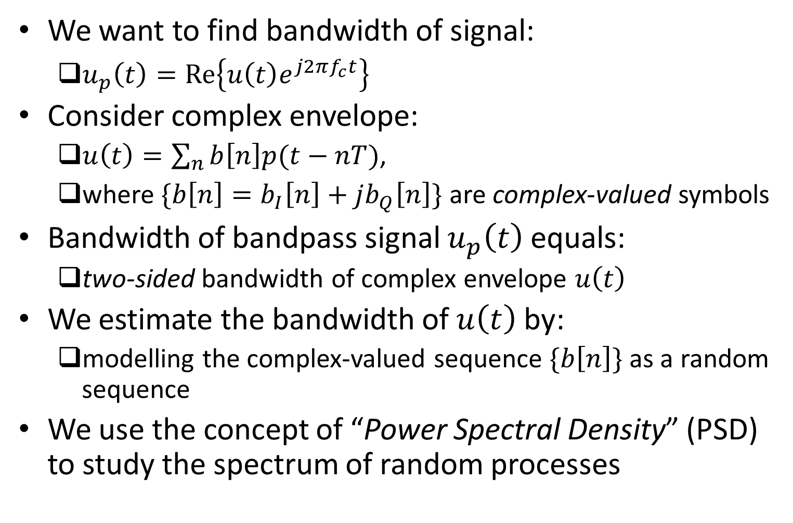
Bandwidth
We want to find bandwidth of signal:
$u_{p}\left(t\right)=Re\left\{u\left(t\right)e^{j2πf_{c}t}\right\}$
Consider complex envelope:
$u\left(t\right)=\sum_{n}{b\left[n\right]p(t−nT)}$,
where $\{b\left[n\right]=b_{I}\left[n\right]+jb_{Q}\left[n\right]\}$ are complex-valued symbols
Bandwidth of bandpass signal $u_{p}\left(t\right)$ equals:
two-sided bandwidth of complex envelope $u\left(t\right)$
We estimate the bandwidth of $u\left(t\right)$ by:
modelling the complex-valued sequence $\{b\left[n\right]\}$ as a random sequence
We use the concept of “Power Spectral Density” (PSD) to study the spectrum of random processes

Slide 14
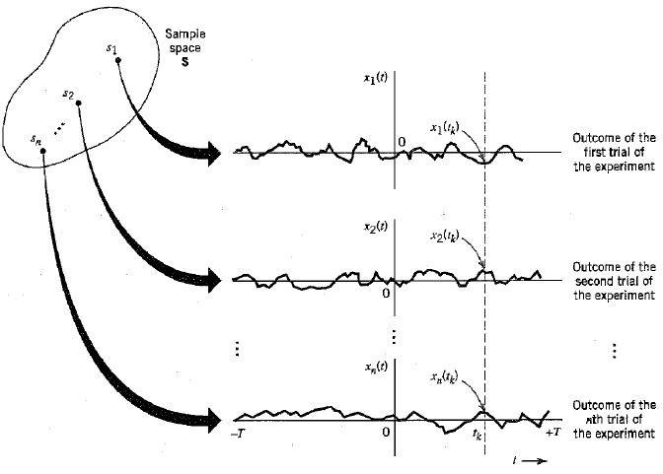
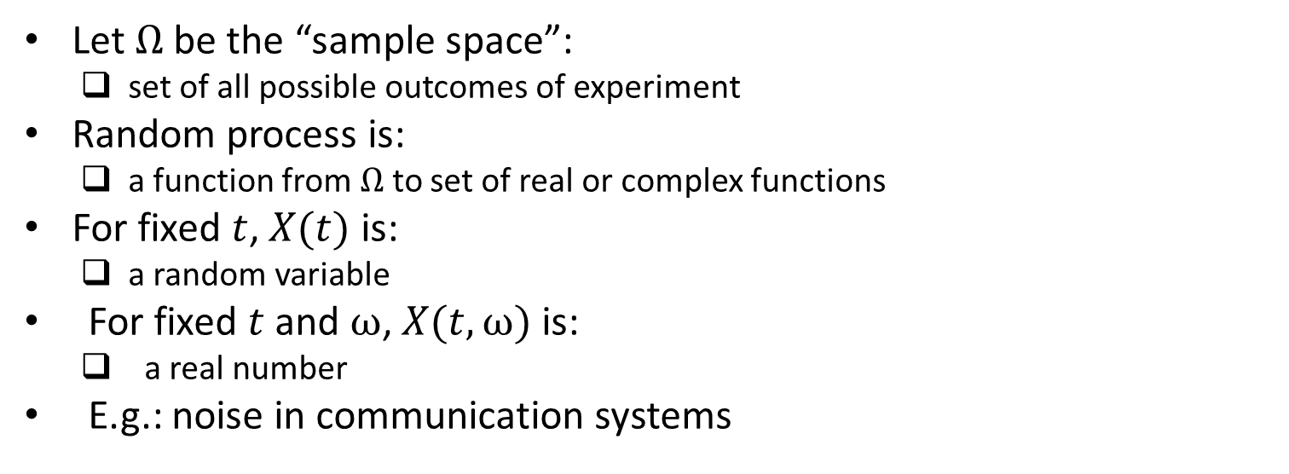
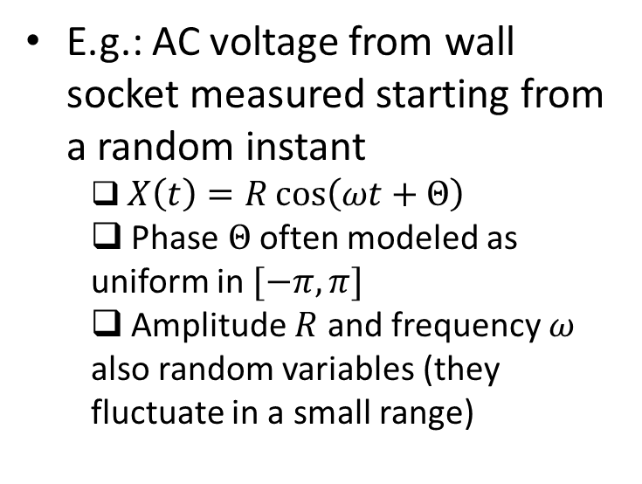
Random Process
Let $Ω$ be the “sample space”:
set of all possible outcomes of experiment
Random process is:
a function from $Ω$ to set of real or complex functions
For fixed $t$, $X(t)$ is:
a random variable
For fixed $t$ and $ω$, $X(t,ω)$ is:
a real number
E.g.: noise in communication systems
E.g.: AC voltage from wall socket measured starting from a random instant
$X\left(t\right)=R\cos\left(ωt+Θ\right)$
Phase $Θ$ often modeled as uniform in $[−π,π]$
Amplitude $R$ and frequency $ω$ also random variables (they fluctuate in a small range)
Ref: “Communication Systems” by Haykin

Slide 15
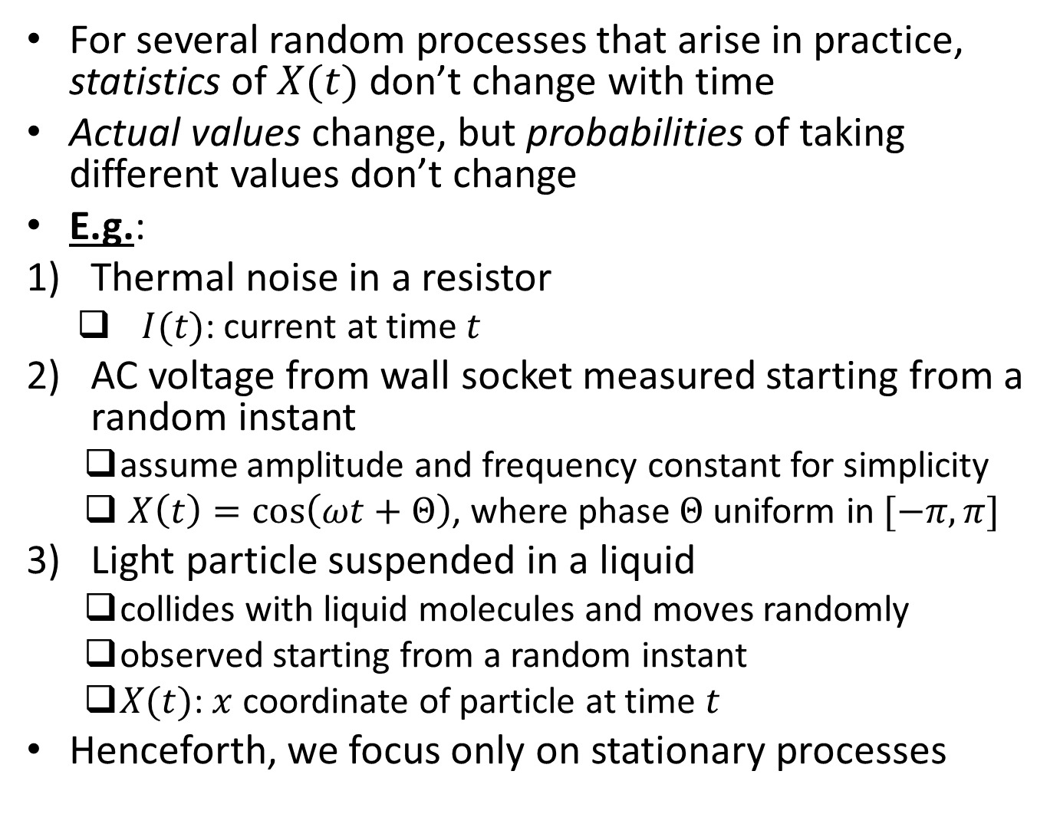
Stationary Processes
For several random processes that arise in practice, statistics of $X(t)$ don’t change with time
Actual values change, but probabilities of taking different values don’t change
E.g.:
Thermal noise in a resistor
$I(t)$: current at time $t$
AC voltage from wall socket measured starting from a random instant
assume amplitude and frequency constant for simplicity
$X\left(t\right)=\cos\left(ωt+Θ\right)$, where phase $Θ$ uniform in $[−π,π]$
Light particle suspended in a liquid
collides with liquid molecules and moves randomly
observed starting from a random instant
$X(t)$: $x$ coordinate of particle at time $t$
Henceforth, we focus only on stationary processes

Slide 16
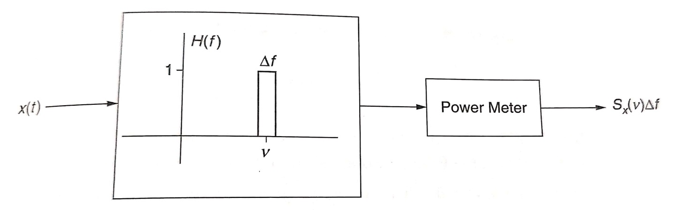
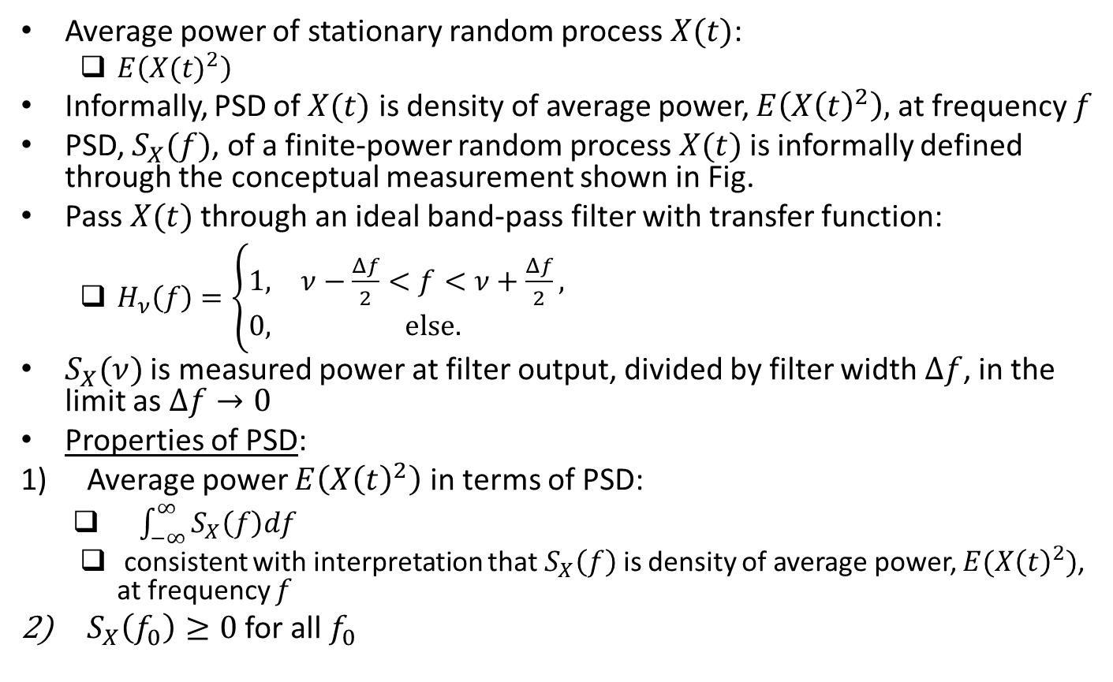
Power Spectral Density (PSD)
Average power of stationary random process $X(t)$:
$E\left({X(t)}^{2}\right)$
Informally, PSD of $X(t)$ is density of average power, $E\left({X\left(t\right)}^{2}\right),$ at frequency $f$
PSD, $S_{X}(f)$, of a finite-power random process $X(t)$ is informally defined through the conceptual measurement shown in Fig.
Pass $X(t)$ through an ideal band-pass filter with transfer function:
$H_{ν}\left(f\right)=\left\{\begin{matrix}1, & ν−\frac{Δf}{2}<f<ν+\frac{Δf}{2}, \\ 0, & else.\end{matrix}\right.$
$S_{X}(ν)$ is measured power at filter output, divided by filter width $Δf$, in the limit as $Δf→0$
Properties of PSD:
Average power $E\left({X\left(t\right)}^{2}\right)$ in terms of PSD:
$\int_{−∞}^{∞}{S_{X}\left(f\right)df}$
consistent with interpretation that $S_{X}\left(f\right)$ is density of average power, $E({X\left(t\right)}^{2})$, at frequency $f$
$S_{X}\left(f_{0}\right)≥0$ for all $f_{0}$
Ref: U. Madhow, “Introduction to Communication Systems”

Slide 17
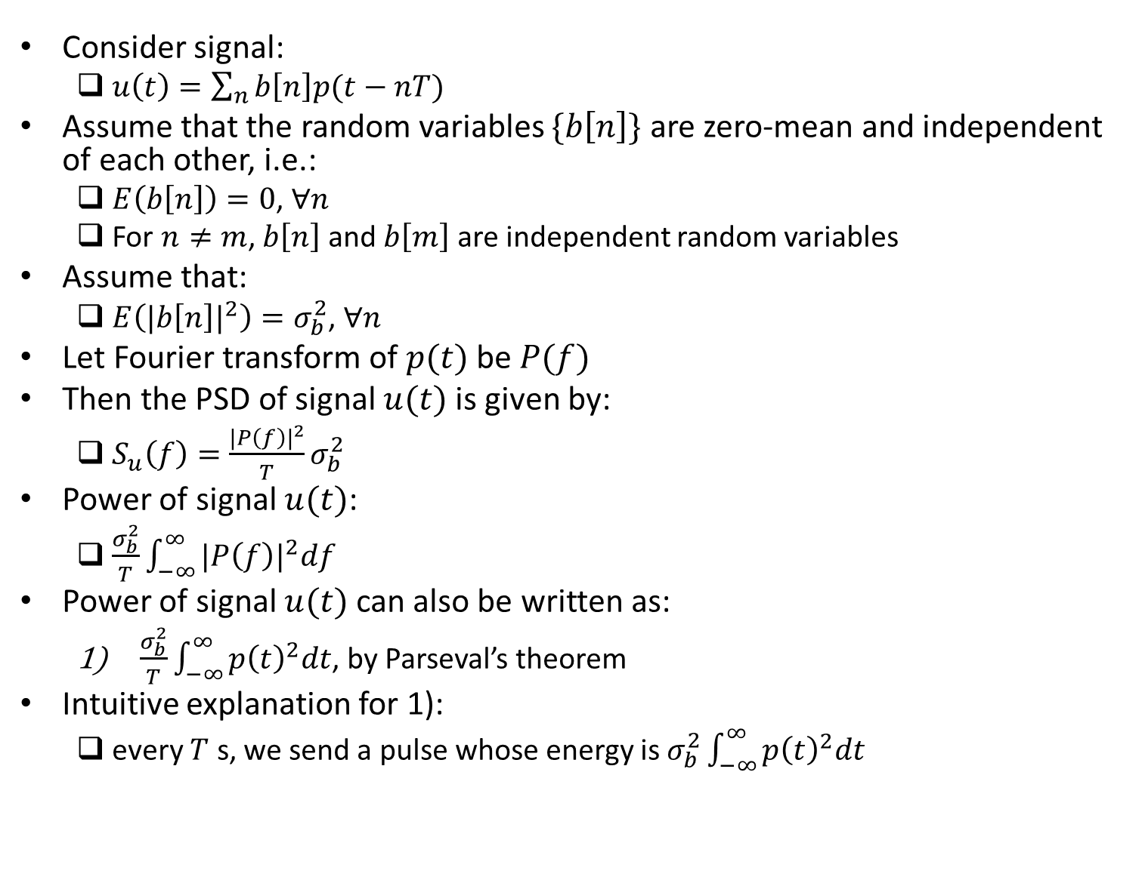
PSD of Digitally Modulated Signal
Consider signal:
$u\left(t\right)=\sum_{n}{b\left[n\right]p(t−nT)}$
Assume that the random variables $\{b\left[n\right]\}$ are zero-mean and independent of each other, i.e.:
$E\left(b\left[n\right]\right)=0$, $∀n$
For $n≠m$, $b\left[n\right]$ and $b\left[m\right]$ are independent random variables
Assume that:
$E\left(|{b\left[n\right]|}^{2}\right)=σ_{b}^{2}$, $∀n$
Let Fourier transform of $p(t)$ be $P(f)$
Then the PSD of signal $u(t)$ is given by:
$S_{u}\left(f\right)=\frac{{|P\left(f\right)|}^{2}}{T}σ_{b}^{2}$
Power of signal $u(t)$:
$\frac{σ_{b}^{2}}{T}\int_{−∞}^{∞}{{|P\left(f\right)|}^{2}df}$
Power of signal $u(t)$ can also be written as:
$\frac{σ_{b}^{2}}{T}\int_{−∞}^{∞}{{p\left(t\right)}^{2}dt}$, by Parseval’s theorem
Intuitive explanation for 1):
every $T$ s, we send a pulse whose energy is $σ_{b}^{2}\int_{−∞}^{∞}{{p\left(t\right)}^{2}dt}$

Slide 18
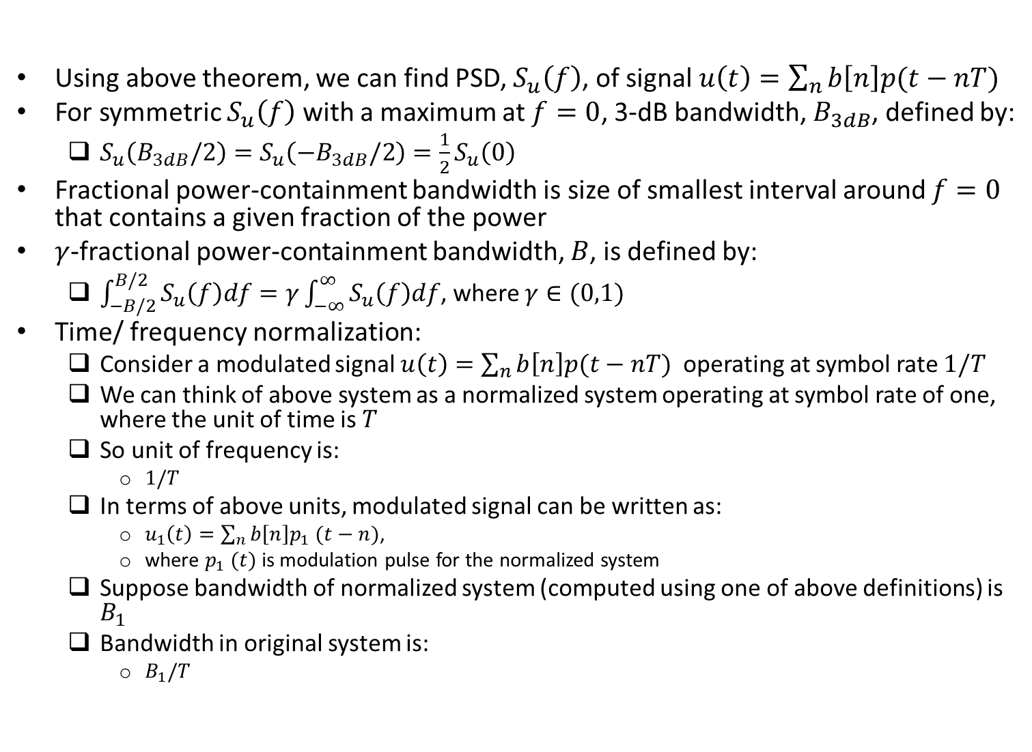
Bandwidth
Using above theorem, we can find PSD, $S_{u}\left(f\right)$, of signal $u\left(t\right)=\sum_{n}{b\left[n\right]p(t−nT)}$
For symmetric $S_{u}\left(f\right)$ with a maximum at $f=0$, 3-dB bandwidth, $B_{3dB}$, defined by:
$S_{u}\left(B_{3dB}/2\right)=S_{u}\left(−B_{3dB}/2\right)=\frac{1}{2}S_{u}\left(0\right)$
Fractional power-containment bandwidth is size of smallest interval around $f=0$ that contains a given fraction of the power
$γ$-fractional power-containment bandwidth, $B$, is defined by:
$\int_{−B/2}^{B/2}{S_{u}\left(f\right)df}=γ\int_{−∞}^{∞}{S_{u}\left(f\right)df}$, where $γ∈(0,1)$
Time/ frequency normalization:
Consider a modulated signal $u\left(t\right)=\sum_{n}{b\left[n\right]p(t−nT)}$ operating at symbol rate $1/T$
We can think of above system as a normalized system operating at symbol rate of one, where the unit of time is $T$
So unit of frequency is:
$1/T$
In terms of above units, modulated signal can be written as:
$u_{1}\left(t\right)=\sum_{n}{b\left[n\right]p_{1} (t−n)}$,
where $p_{1} (t)$ is modulation pulse for the normalized system
Suppose bandwidth of normalized system (computed using one of above definitions) is $B_{1}$
Bandwidth in original system is:
$B_{1}/T$

Slide 19
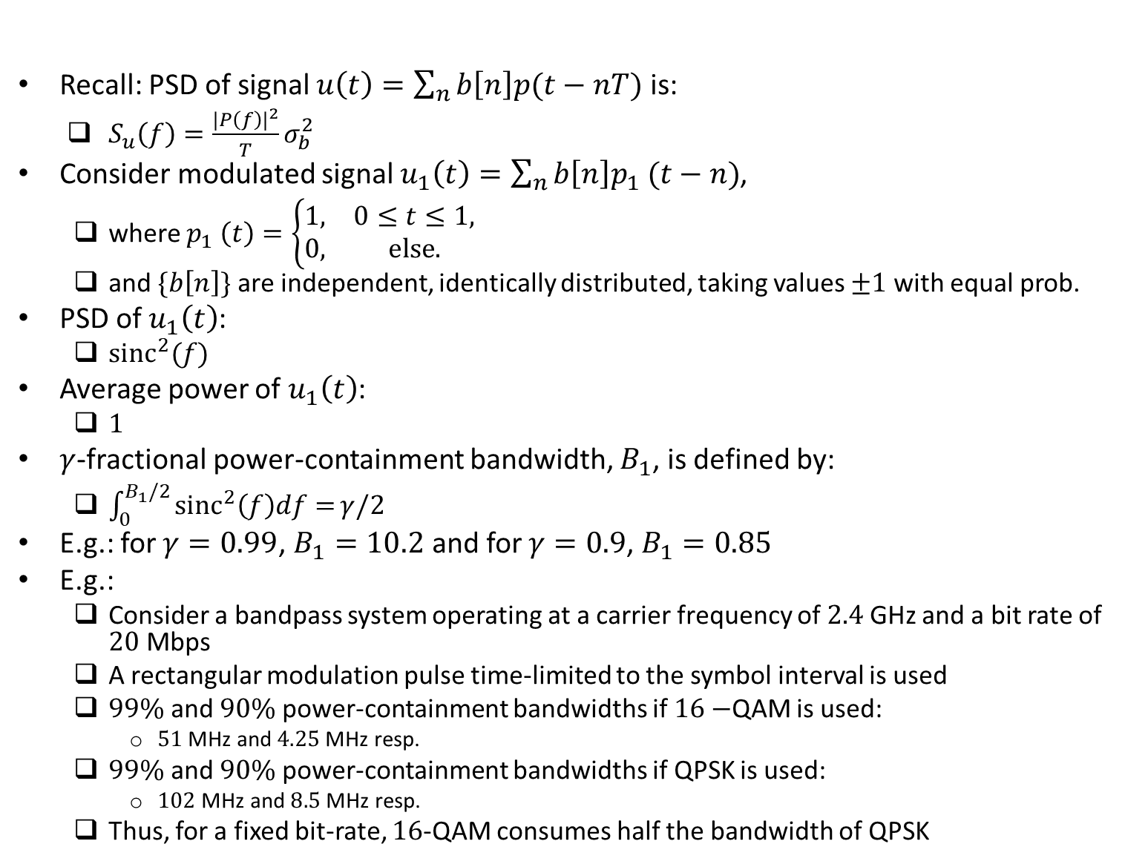
Modulated Signal with Rectangular Pulses
Recall: PSD of signal $u\left(t\right)=\sum_{n}{b\left[n\right]p(t−nT)}$ is:
$S_{u}\left(f\right)=\frac{{|P\left(f\right)|}^{2}}{T}σ_{b}^{2}$
Consider modulated signal $u_{1}\left(t\right)=\sum_{n}{b\left[n\right]p_{1} (t−n)}$,
where $p_{1} \left(t\right)=\left\{\begin{matrix}1, & 0≤t≤1, \\ 0, & else.\end{matrix}\right.$
and $\{b\left[n\right]\}$ are independent, identically distributed, taking values $±1$ with equal prob.
PSD of $u_{1}\left(t\right)$:
${sinc}^{2}(f)$
Average power of $u_{1}\left(t\right)$:
$1$
$γ$-fractional power-containment bandwidth, $B_{1}$, is defined by:
$\int_{0}^{B_{1}/2}{{sinc}^{2}\left(f\right)df=}γ/2$
E.g.: for $γ=0.99$, $B_{1}=10.2$ and for $γ=0.9$, $B_{1}=0.85$
E.g.:
Consider a bandpass system operating at a carrier frequency of $2.4$ GHz and a bit rate of $20$ Mbps
A rectangular modulation pulse time-limited to the symbol interval is used
$99\%$ and $90\%$ power-containment bandwidths if $16−$QAM is used:
$51$ MHz and $4.25$ MHz resp.
$99\%$ and $90\%$ power-containment bandwidths if QPSK is used:
$102$ MHz and $8.5$ MHz resp.
Thus, for a fixed bit-rate, $16$-QAM consumes half the bandwidth of QPSK

Slide 20
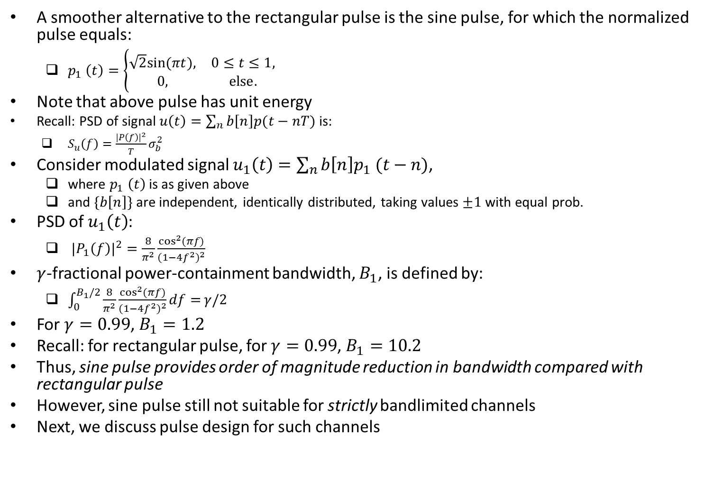
Modulated Signal with Sine Pulses
A smoother alternative to the rectangular pulse is the sine pulse, for which the normalized pulse equals:
$p_{1} \left(t\right)=\left\{\begin{matrix}\sqrt{2}sin⁡(πt), & 0≤t≤1, \\ 0, & else.\end{matrix}\right.$
Note that above pulse has unit energy
Recall: PSD of signal $u\left(t\right)=\sum_{n}{b\left[n\right]p(t−nT)}$ is:
$S_{u}\left(f\right)=\frac{{|P\left(f\right)|}^{2}}{T}σ_{b}^{2}$
Consider modulated signal $u_{1}\left(t\right)=\sum_{n}{b\left[n\right]p_{1} (t−n)}$,
where $p_{1} \left(t\right)$ is as given above
and $\{b\left[n\right]\}$ are independent, identically distributed, taking values $±1$ with equal prob.
PSD of $u_{1}\left(t\right)$:
${|P_{1}\left(f\right)|}^{2}=\frac{8}{π^{2}}\frac{\cos^{2}(πf)}{{(1−4f^{2})}^{2}}$
$γ$-fractional power-containment bandwidth, $B_{1}$, is defined by:
$\int_{0}^{B_{1}/2}{\frac{8}{π^{2}}\frac{\cos^{2}(πf)}{{(1−4f^{2})}^{2}}df=}γ/2$
For $γ=0.99$, $B_{1}=1.2$
Recall: for rectangular pulse, for $γ=0.99$, $B_{1}=10.2$
Thus, sine pulse provides order of magnitude reduction in bandwidth compared with rectangular pulse
However, sine pulse still not suitable for strictly bandlimited channels
Next, we discuss pulse design for such channels

Slide 21
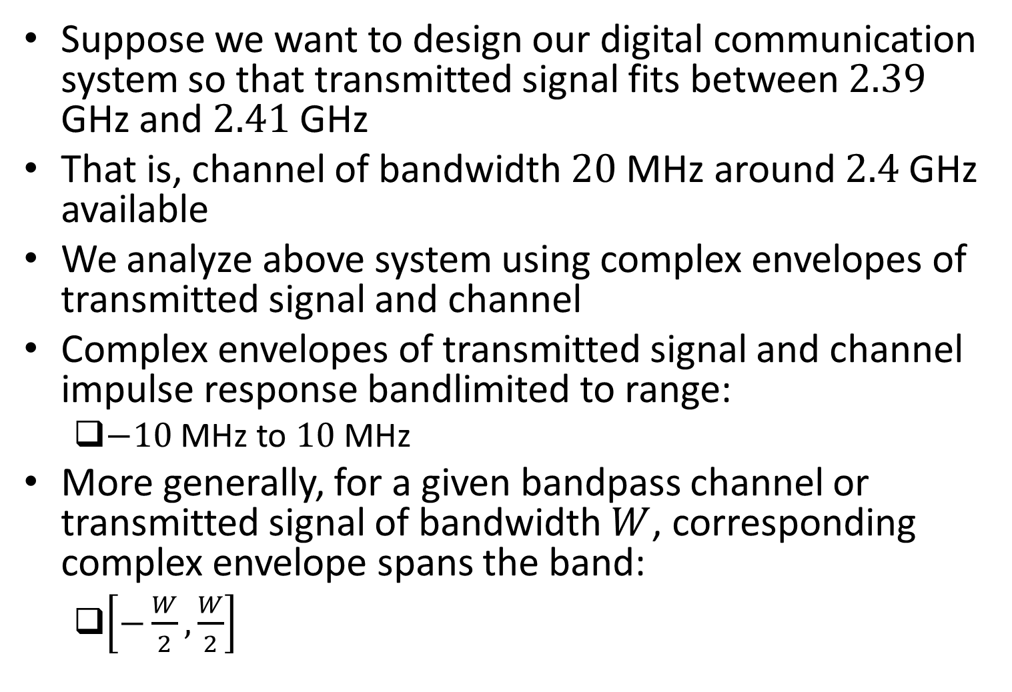
Design for Bandlimited Channels
Suppose we want to design our digital communication system so that transmitted signal fits between $2.39$ GHz and $2.41$ GHz
That is, channel of bandwidth $20$ MHz around $2.4$ GHz available
We analyze above system using complex envelopes of transmitted signal and channel
Complex envelopes of transmitted signal and channel impulse response bandlimited to range:
$−10$ MHz to $10$ MHz
More generally, for a given bandpass channel or transmitted signal of bandwidth $W$, corresponding complex envelope spans the band:
$\left[−\frac{W}{2},\frac{W}{2}\right]$

Slide 22
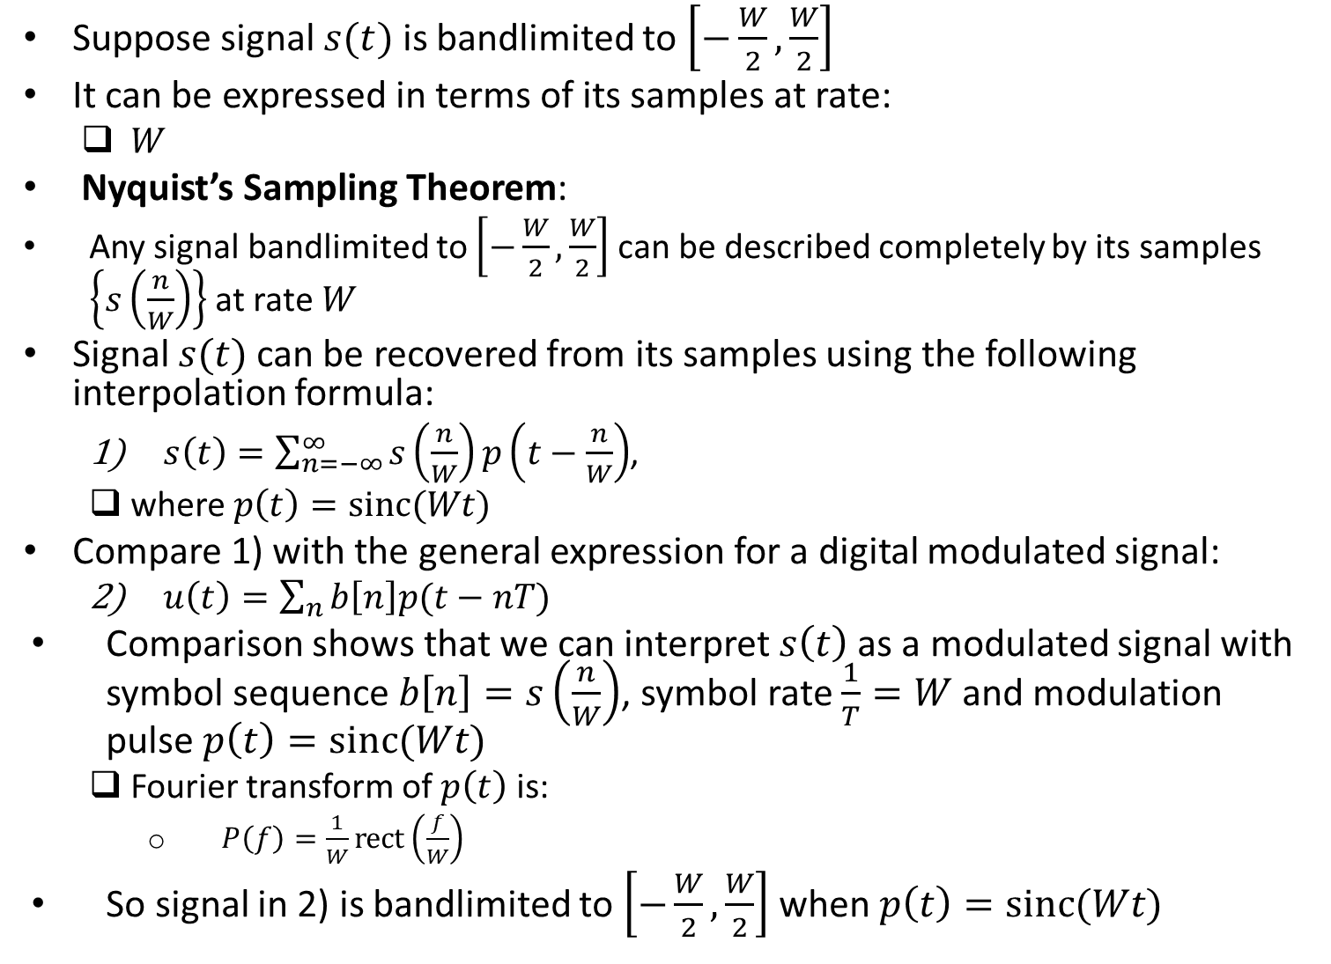
Nyquist’s Sampling Theorem
Suppose signal $s(t)$ is bandlimited to $\left[−\frac{W}{2},\frac{W}{2}\right]$
It can be expressed in terms of its samples at rate:
$W$
Nyquist’s Sampling Theorem:
Any signal bandlimited to $\left[−\frac{W}{2},\frac{W}{2}\right]$ can be described completely by its samples $\left\{s\left(\frac{n}{W}\right)\right\}$ at rate $W$
Signal $s(t)$ can be recovered from its samples using the following interpolation formula:
$s\left(t\right)=\sum_{n=−∞}^{∞}{s\left(\frac{n}{W}\right)p\left(t−\frac{n}{W}\right)}$,
where $p\left(t\right)=sinc(Wt)$
Compare 1) with the general expression for a digital modulated signal:
$u\left(t\right)=\sum_{n}{b\left[n\right]p(t−nT)}$
Comparison shows that we can interpret $s\left(t\right)$ as a modulated signal with symbol sequence $b\left[n\right]=s\left(\frac{n}{W}\right)$, symbol rate $\frac{1}{T}=W$ and modulation pulse $p\left(t\right)=sinc(Wt)$
Fourier transform of $p\left(t\right)$ is:
$P\left(f\right)=\frac{1}{W}rect\left(\frac{f}{W}\right)$
So signal in 2) is bandlimited to $\left[−\frac{W}{2},\frac{W}{2}\right]$ when $p\left(t\right)=sinc(Wt)$

Slide 23
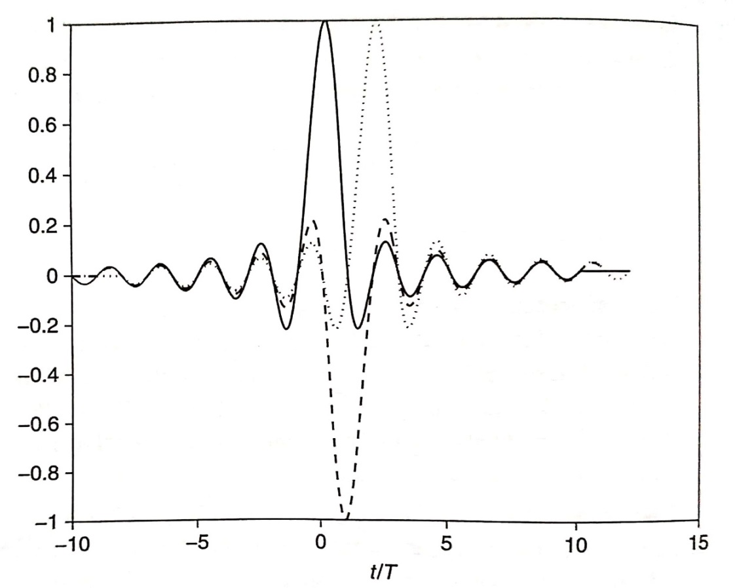
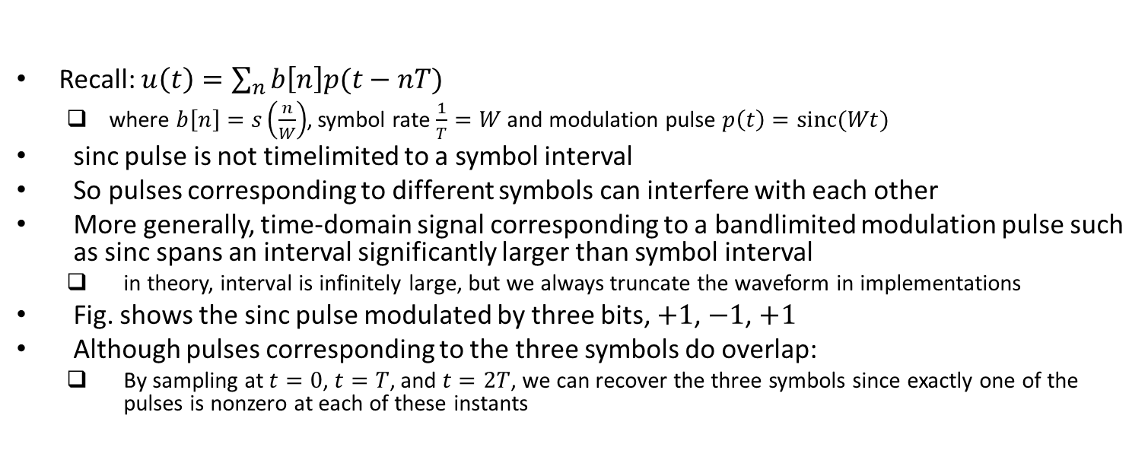
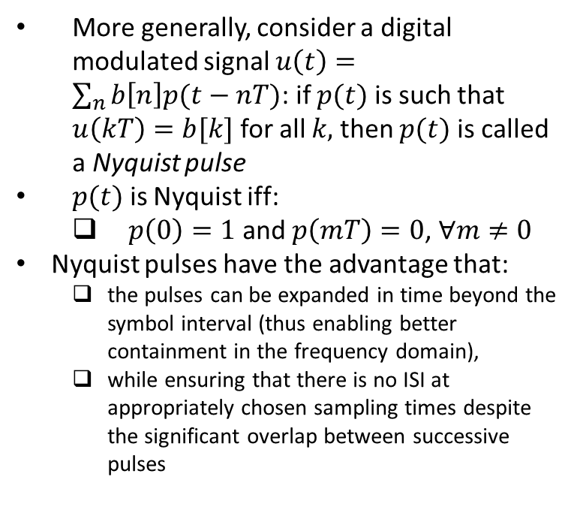
Intersymbol Interference
Recall: $u\left(t\right)=\sum_{n}{b\left[n\right]p(t−nT)}$
where $b\left[n\right]=s\left(\frac{n}{W}\right)$, symbol rate $\frac{1}{T}=W$ and modulation pulse $p\left(t\right)=sinc(Wt)$
sinc pulse is not timelimited to a symbol interval
So pulses corresponding to different symbols can interfere with each other
More generally, time-domain signal corresponding to a bandlimited modulation pulse such as sinc spans an interval significantly larger than symbol interval
in theory, interval is infinitely large, but we always truncate the waveform in implementations
Fig. shows the sinc pulse modulated by three bits, $+1$, $−1$, $+1$
Although pulses corresponding to the three symbols do overlap:
By sampling at $t=0$, $t=T$, and $t=2T$, we can recover the three symbols since exactly one of the pulses is nonzero at each of these instants
More generally, consider a digital modulated signal $u\left(t\right)=\sum_{n}{b\left[n\right]p(t−nT)}$: if $p(t)$ is such that $u\left(kT\right)=b[k]$ for all $k,$ then $p(t)$ is called a Nyquist pulse
$p(t)$ is Nyquist iff:
$p\left(0\right)=1$ and $p\left(mT\right)=0$, $∀m≠0$
Nyquist pulses have the advantage that:
the pulses can be expanded in time beyond the symbol interval (thus enabling better containment in the frequency domain),
while ensuring that there is no ISI at appropriately chosen sampling times despite the significant overlap between successive pulses
Ref: U. Madhow, “Introduction to Communication Systems”

Slide 24
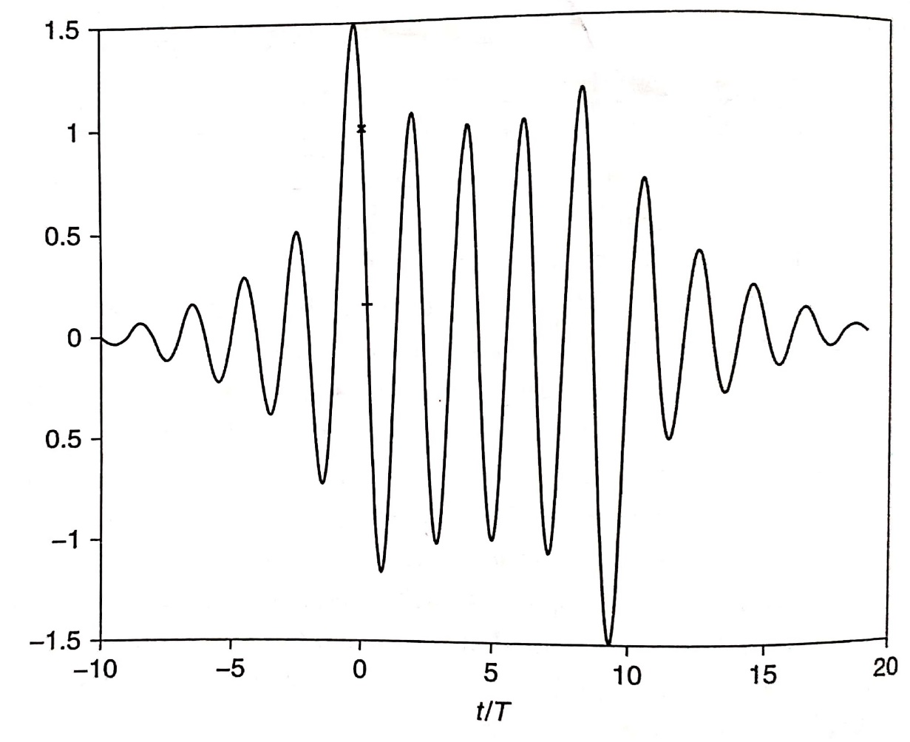
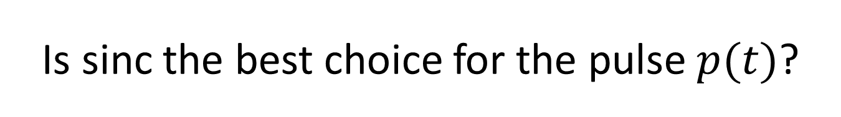
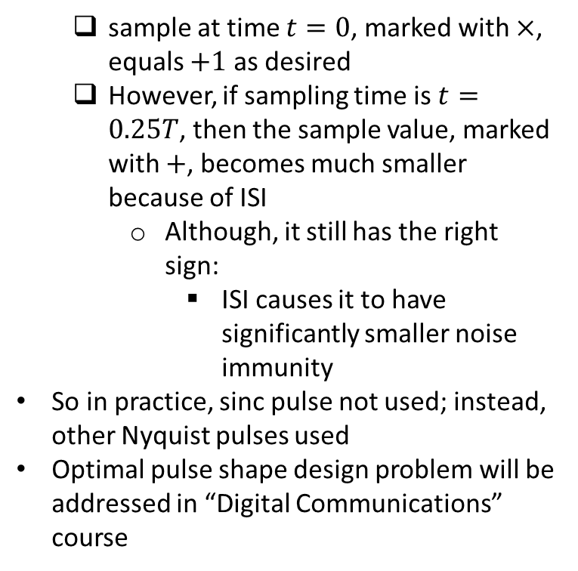
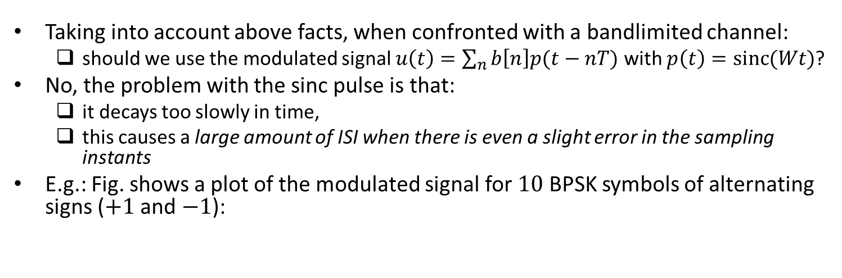
Is sinc the best choice for the pulse $p(t)$?
Taking into account above facts, when confronted with a bandlimited channel:
should we use the modulated signal $u\left(t\right)=\sum_{n}{b\left[n\right]p(t−nT)}$ with $p\left(t\right)=sinc(Wt)$?
No, the problem with the sinc pulse is that:
it decays too slowly in time,
this causes a large amount of ISI when there is even a slight error in the sampling instants
E.g.: Fig. shows a plot of the modulated signal for $10$ BPSK symbols of alternating signs ($+1$ and $−1$):
sample at time $t=0$, marked with $×$, equals $+1$ as desired
However, if sampling time is $t=0.25T$, then the sample value, marked with $+$, becomes much smaller because of ISI
Although, it still has the right sign:
ISI causes it to have significantly smaller noise immunity
So in practice, sinc pulse not used; instead, other Nyquist pulses used
Optimal pulse shape design problem will be addressed in “Digital Communications” course
Ref: U. Madhow, “Introduction to Communication Systems”

Slide 25
Matched Filter

Slide 26
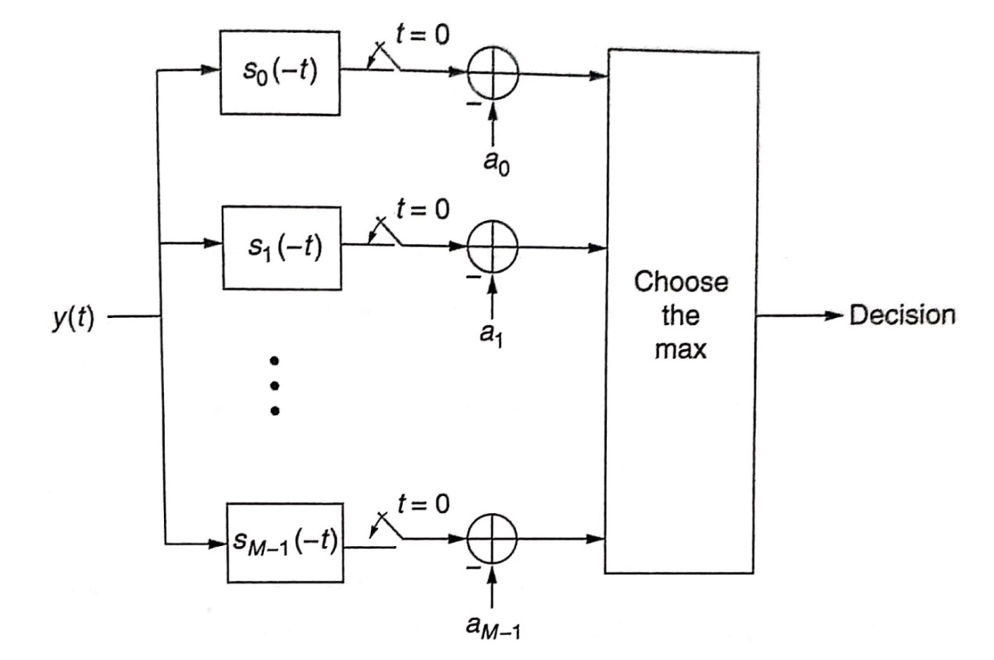
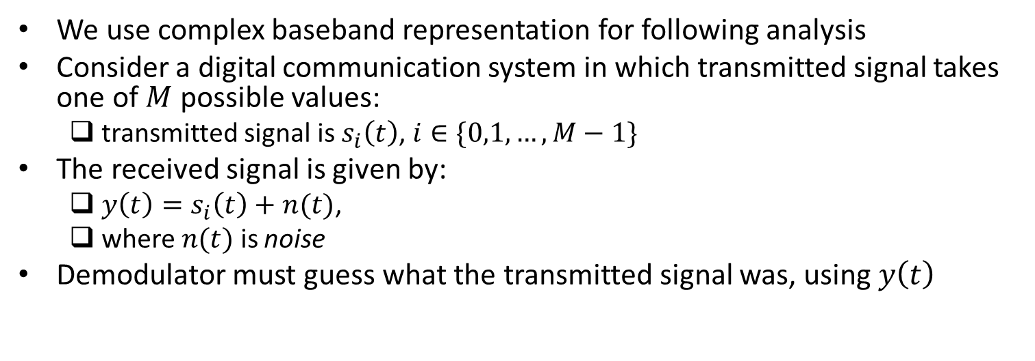
Optimal Demodulation
We use complex baseband representation for following analysis
Consider a digital communication system in which transmitted signal takes one of $M$ possible values:
transmitted signal is $s_{i}\left(t\right)$, $i∈\{0,1,…,M−1\}$
The received signal is given by:
$y\left(t\right)=s_{i}\left(t\right)+n(t)$,
where $n(t)$ is noise
Demodulator must guess what the transmitted signal was, using $y\left(t\right)$
It can be shown that under some mild assumptions, the scheme shown in fig. is the optimal demodulation scheme, i.e., the scheme that minimizes the average probability of error
Note that demodulator contains a bank of “matched filters”
Next, we study why matched filters are used
Ref: U. Madhow, “Introduction to Communication Systems”

Slide 27
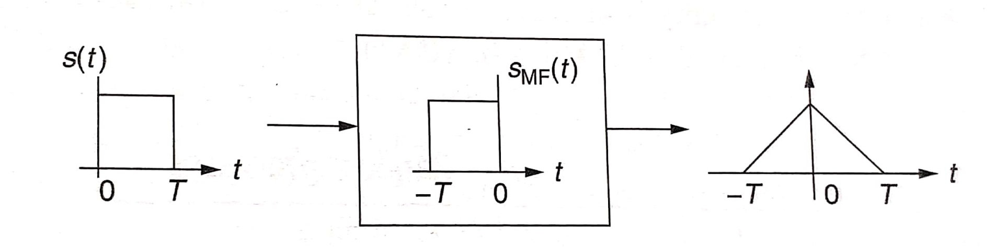
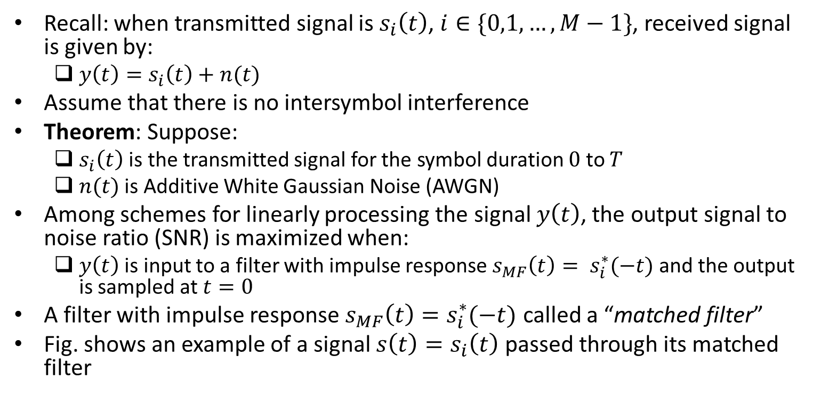
Matched Filter
Recall: when transmitted signal is $s_{i}\left(t\right)$, $i∈\{0,1,…,M−1\}$, received signal is given by:
$y\left(t\right)=s_{i}\left(t\right)+n(t)$
Assume that there is no intersymbol interference
Theorem: Suppose:
$s_{i}\left(t\right)$ is the transmitted signal for the symbol duration $0$ to $T$
$n(t)$ is Additive White Gaussian Noise (AWGN)
Among schemes for linearly processing the signal $y\left(t\right)$, the output signal to noise ratio (SNR) is maximized when:
$y\left(t\right)$ is input to a filter with impulse response $s_{MF}\left(t\right)= s_{i}^{∗}(−t)$ and the output is sampled at $t=0$
A filter with impulse response $s_{MF}\left(t\right)=s_{i}^{∗}(−t)$ called a “matched filter”
Fig. shows an example of a signal $s\left(t\right)=s_{i}\left(t\right)$ passed through its matched filter
Ref: U. Madhow, “Introduction to Communication Systems”

